Slide 1
Assignment-II Explore the heat sink analytical modeling
Group member:
SONG YANG
QU MINGXUAN
XIAO SA

Slide 2
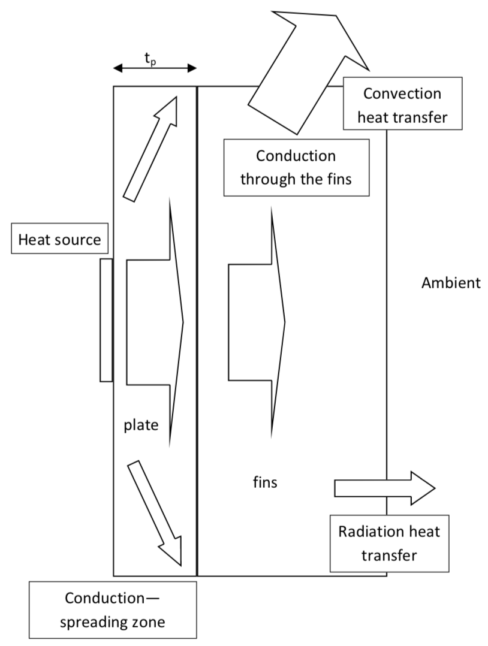
Task1
This figure showing various heat transfer phenomenon in heat sinks.
Rsa, Rbf, Rsp and Rfa, those four resistances will be covered later to match different transfer flux.

Slide 3
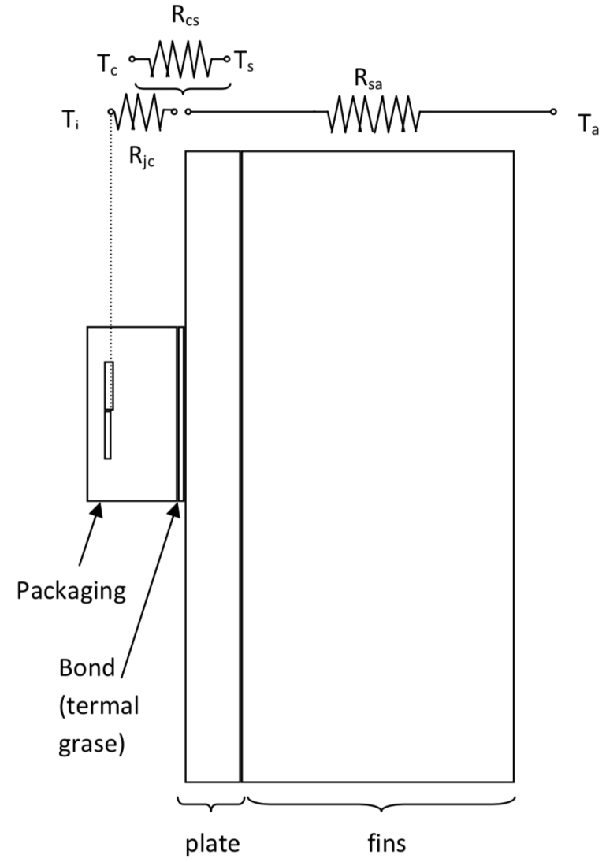
R_{sa}-Sink ambient resistance
R_{sa} is the resistance between the surface of the plate next to the device, and the ambient.
It is the resistance of the heat sink for itself and it involves radiation, convection and conduction heat transfer.
R_{sa}=R_{bf}+R_{sp}+R_{fa}
We division of the heat sink resistance R_{sa} into three
sub-resistances and these resistance will be covered later.
Figure Resistances in a heat sink

Slide 4
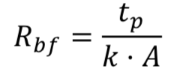
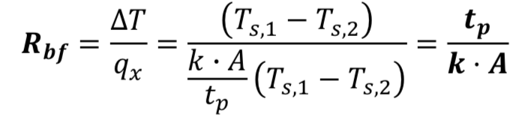
R_{bf}-Plate conduction resistance
R_{bf} is the resistance due to the limited conduction of a flat plate when a uniform flux flows perpendicularly to its surface.
It is directly calculated using the equation:
Following the conduction heat transfer, the thermal resistance finally deduced as:
Where q_{x} is the heat flux (W) in x direction, k is the plate conductivity (W/K∙m), A is the heat transfer area (m²) and t_{p} is the plate thickness.

Slide 5
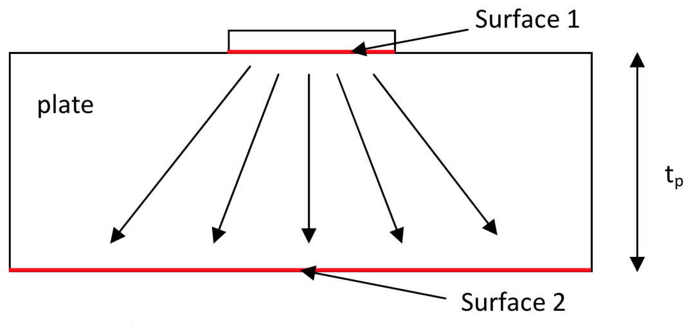
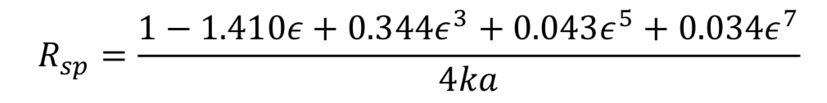

R_{sp} resistance
The R_{sp} resistance is due to the flux spread through the plate thickness.
A plate has two sides.
The works of Yovanovich and Antonetti lead to the following expression for a heat source centered in heat sink surface:
Where ε is the ratio between the heat transfer surface 1 and the heat transfer surface 2, k is the plate conductivity (W/K∙m) and a is the square root of surface 1:
figure plate spreading

Slide 6

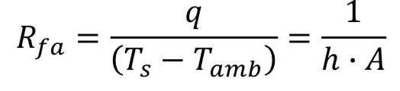
R_{fa} resistance
The resistance between the plate surface that supports the fins and the environment is the R_{fa} resistance.
This resistance includes conduction, convection and radiation heat transfer.
The Newton’s law of cooling is a linear expression
Last expression does not include the conduction resistance through the fins and the radiation heat transfer.
Where q is the heat transfer rate (W), hc is the convection coefficient (W/K∙m²), hr is the radiation equivalent coefficient (W/K∙m²), Ap is the primary area (m²), Af is the extended area (m²), η is the fin efficiency, Ts is the plate surface temperature (K) and the Tamb is the ambient temperature (K).

Slide 7
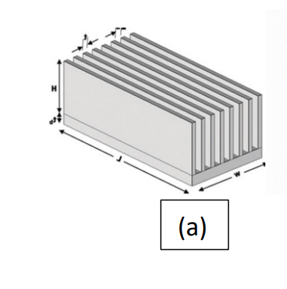
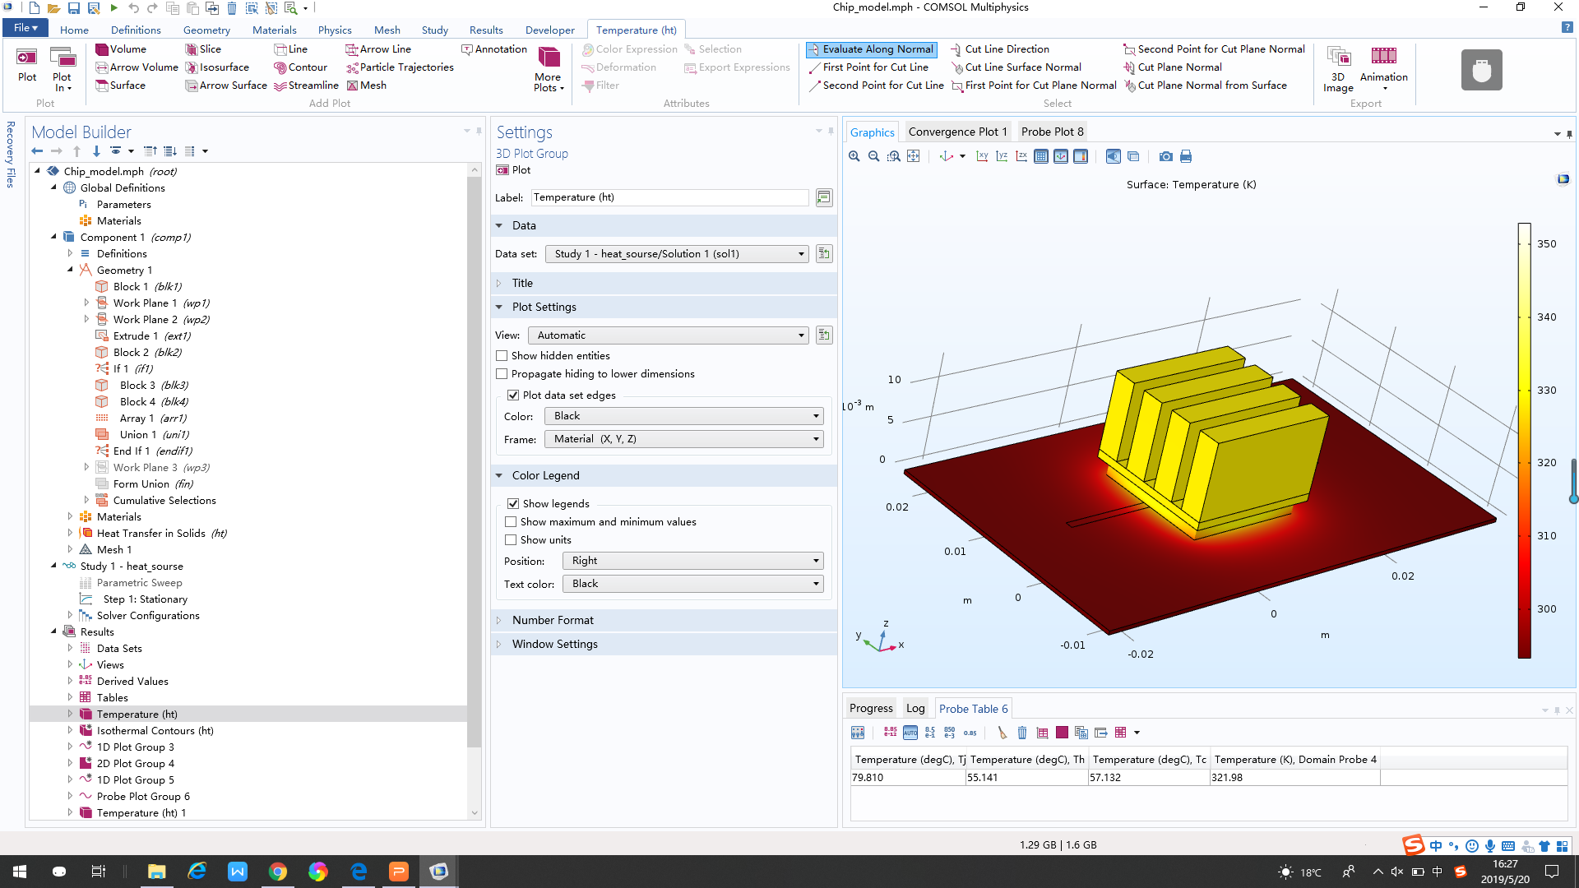
Task1
• Rectangular
A very common heat sink profile is the rectangular parallel fin one. This profile forms U‐channels, where the convection phenomenon is able to be modeled by empirical correlations. Reasonable design spacing, length and thickness of the fin allow the rectangular to achieve an optimal heat dissipation efficiency.

Slide 8
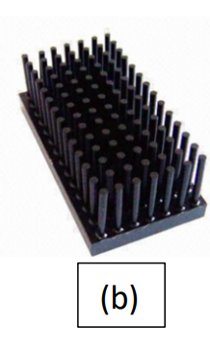
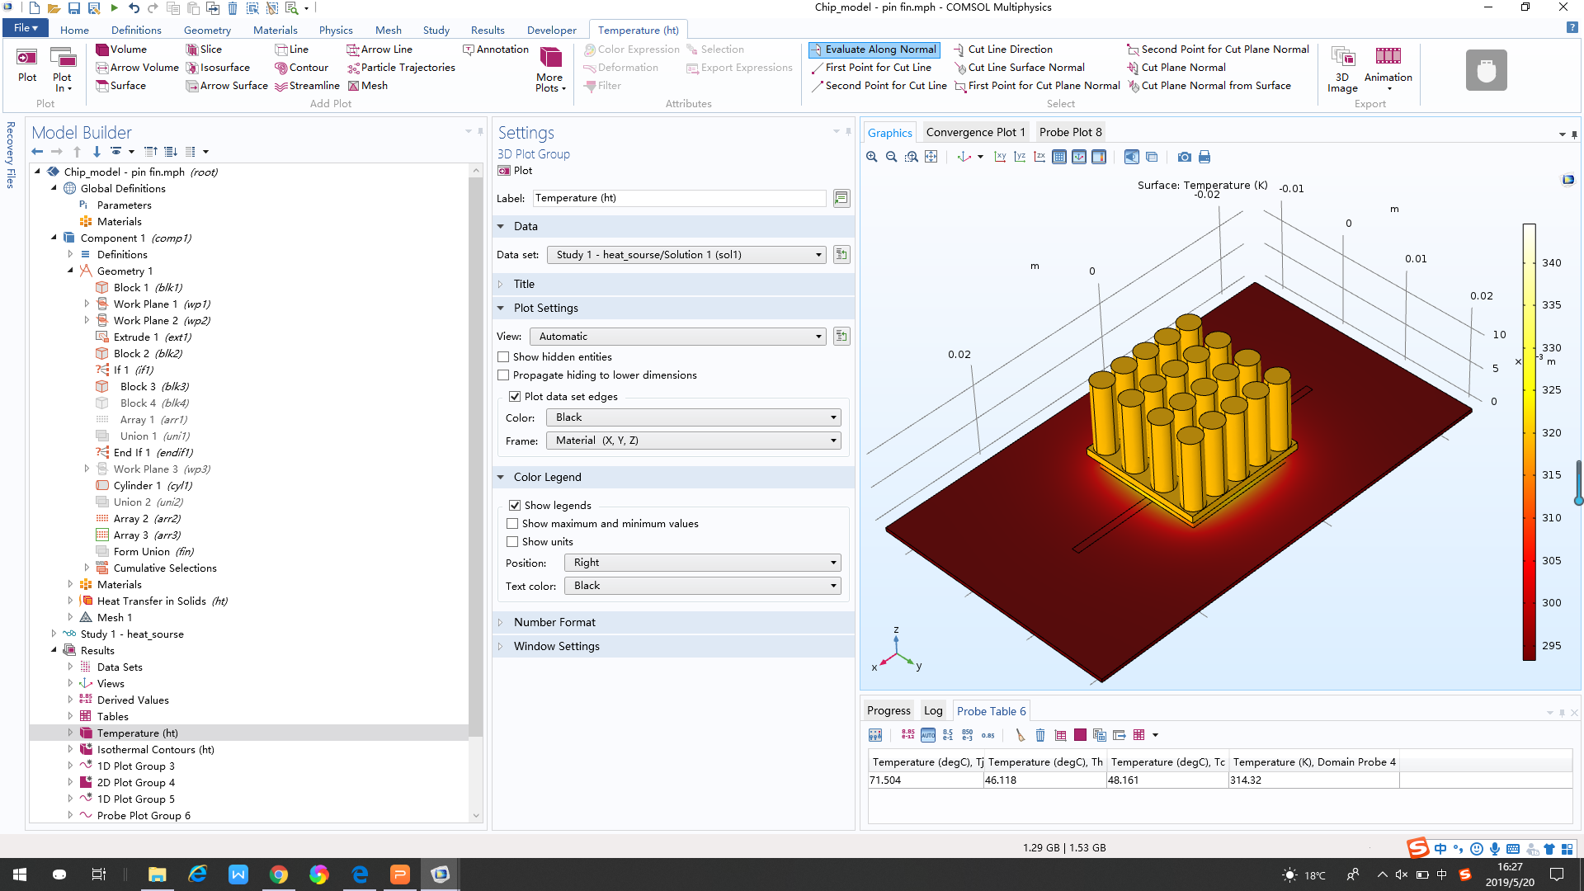
• Pin fin
The pin fin has better heat dissipation performance comparing two heat sink between pin fin and rectangular because the pin fin has bigger surface area and more air circulation.
Reasonable design spacing, length and thickness of the fin also allow the rectangular to achieve an optimal heat dissipation efficiency.

Slide 9
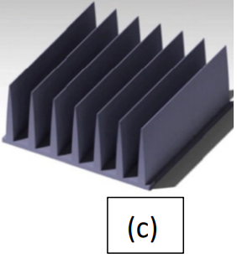
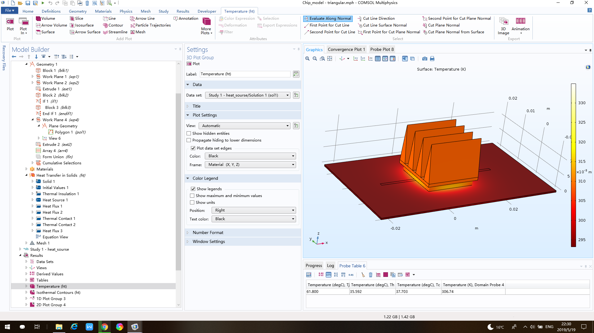
• Triangular fin
a thick bottom and a thinner portion of the air extending from the bottom to the air.
The thickness of the bottom of the heat sink also has a large effect on the heat dissipation efficiency.

Slide 10
Conclusion
Type | Temperature(degC), Tj | Temperature(degC), Th | Temperature(degC), Tc | Temperature(K), Domain Probe
Rectangle | 79.810 | 55.141 | 57.132 | 321.98
Pin fin | 71.504 | 46.118 | 48.161 | 314.32
Triangular | 61.800 | 35.592 | 37.703 | 306.74
We kept the parameters of heat sink width and height the same. The only thing we changed was the type of our heat sink.
From the table above, it's obviously seen that the heat dissipation effect of the triangular heat sink is the best and it has the relatively lowest temperature.

